Slide 1
Power circuit and control circuit for a buck converter

Slide 2
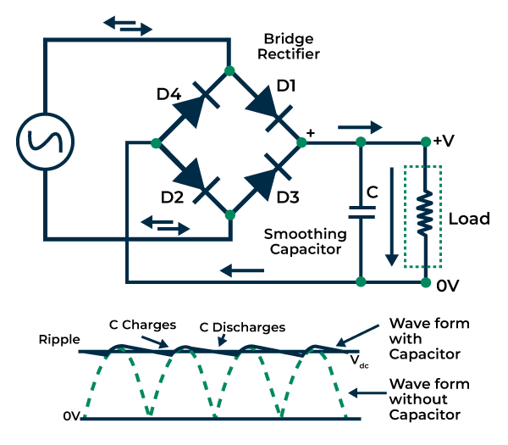
Rectifier circuit:(AC TO DC CONVERSION)
Using full bridge rectifier:
The efficiency of the bridge rectifier is higher than the efficiency of a half-wave rectifier. However, the rectifier efficiency of the bridge rectifier and the centre-tapped full-wave rectifier is the same.
Output voltage of this rectifier shows less ripple
They have low power loss because no voltage signal
is wasted in the rectification process

Slide 3
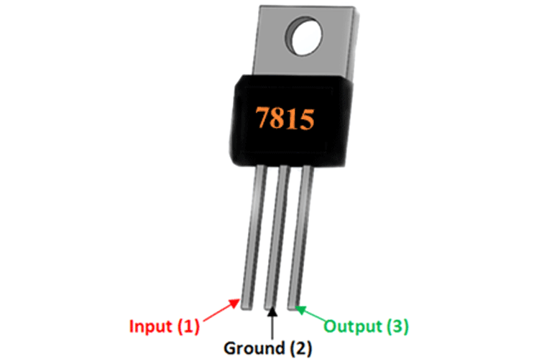
IC 7815 (Voltage regulator)
7805 voltage regulator provides 15V Positive voltage as output to provide a convenient power source for most TTL components.
78- indicates it is a positive voltage regulator, 15- indicates it provides output of 15 volts.
Features-
Constant +15V output regulator to power microcontrollers and sensors in most of the projects
Adjustable Output Regulator
Current Limiter for certain applications
Regulated Dual Supply
Output Polarity-Reversal-Protection Circuit

Slide 4
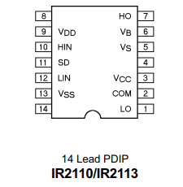
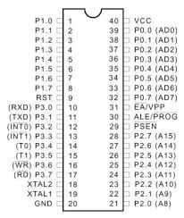
IR2110 :
The IR2110 is a high voltage, high speed power MOSFET and IGBT driver with independent high and low side referenced output channels.
The operating supply voltage range for IR2110 is 10 to 20 volt and output current is 2.5A.
IR2110 comes in 14 pin through-hole PDIP package
AT89C52 (8051 MICROCONTROLLER):
Used to generate square pulses using timer interrupt.
The AT89C52 is a low-power, high-performance CMOS 8-bit microcomputer with 8Kbytes of
Flash programmable and erasable read only memory (PEROM).

Slide 5
BUCK CONVERTER:
A buck converter is a type of DC-DC converter that steps down a higher input voltage to a lower output voltage.
The main components include a switch (usually a MOSFET or IGBT), a diode, and an LC filter, each vital for the converter’s functionality.
PWM controls the timing of the switch in a buck converter, crucial for regulating output voltage and minimizing ripples.
Vo =D*Vin (D is the duty cycle).
Applications:
1. It is used in battery power systems such as battery chargers for mobile phones, laptops, and power banks
2. It is used as a point of load converters for PCs and motherboards.
3. It is used in power audio amplifier applications.
4. It is used in solar chargers.

Slide 6
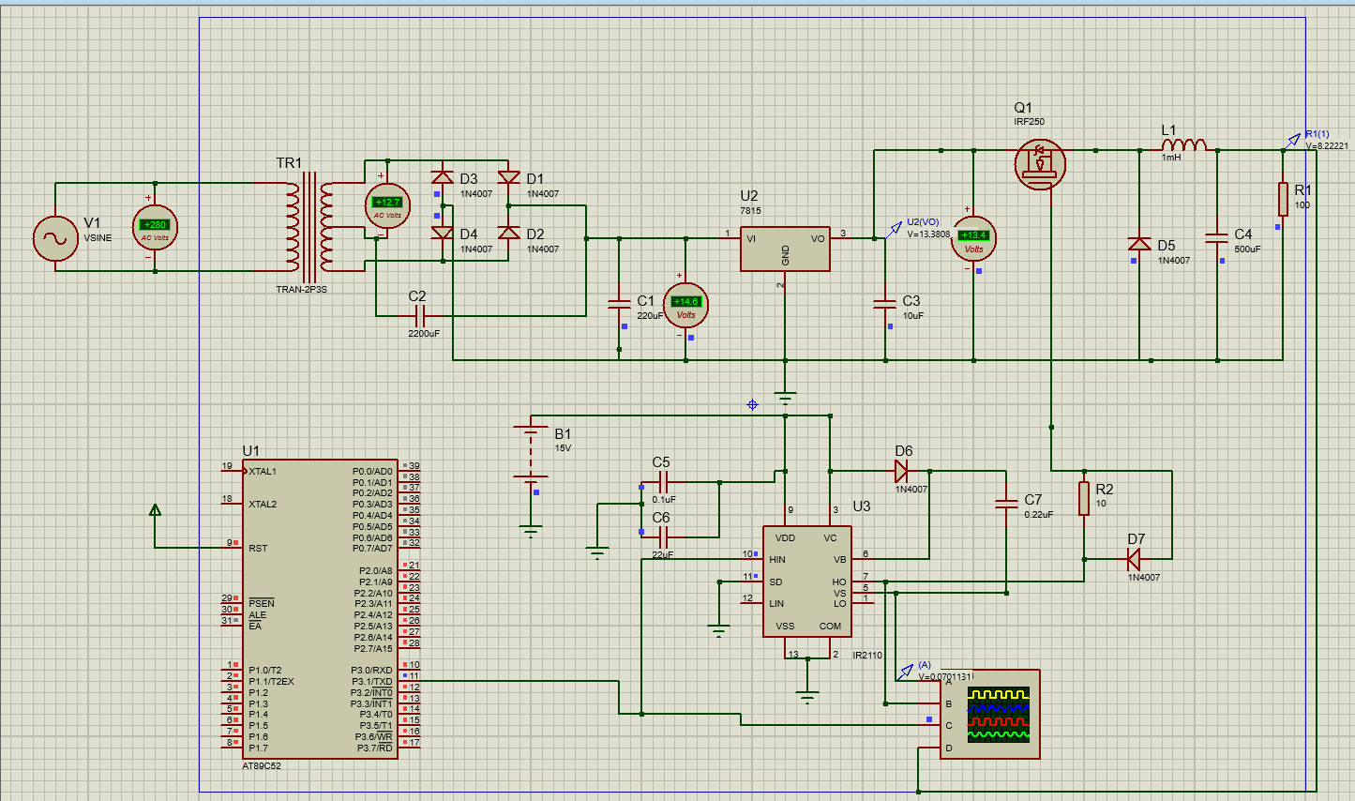
Circuit connection:

Slide 7
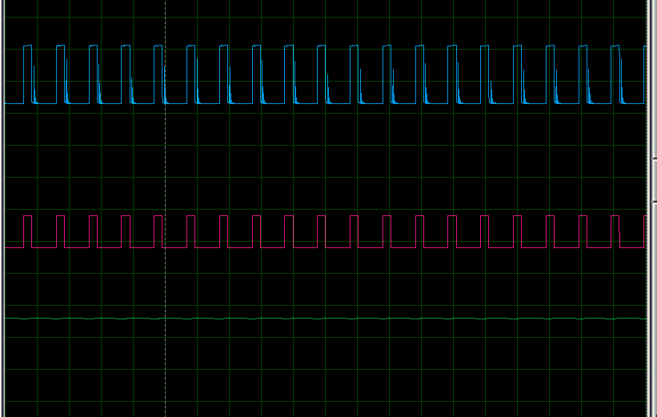
Simulation results:

Slide 8
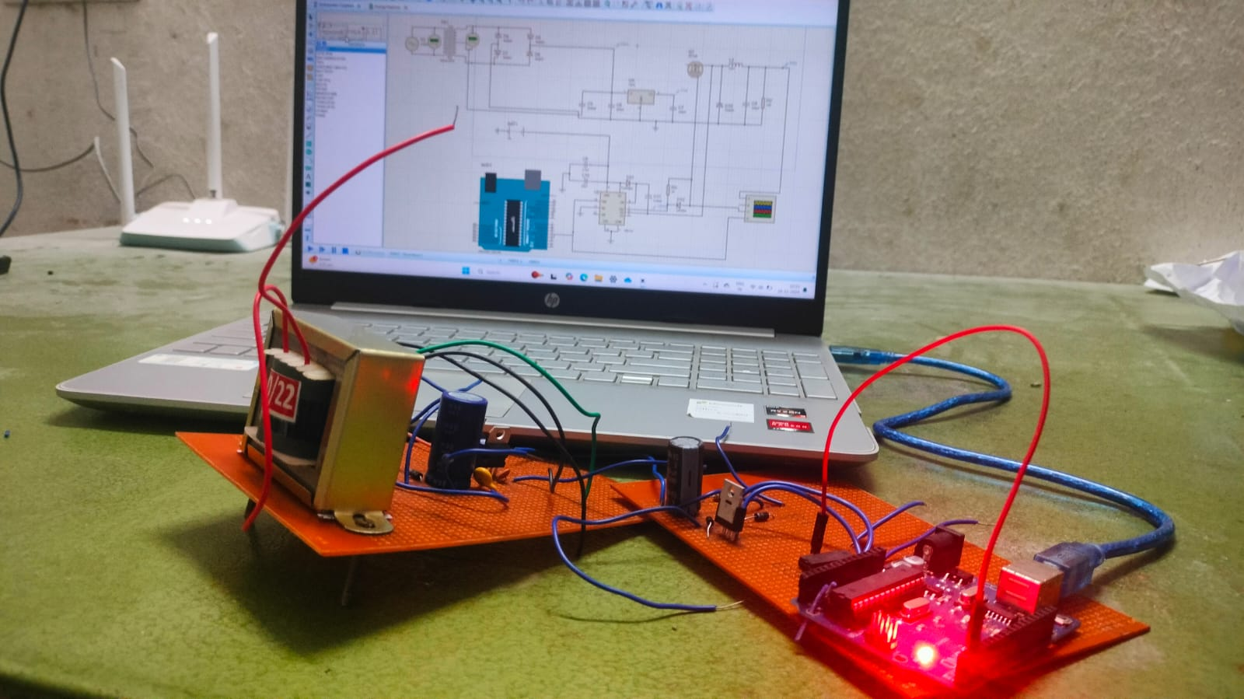
Hardware implementation:

